Slide 1
Stepping into Web Arena
Sajid Rabbani
Esenteq

Slide 2
Why do we need to learn web programming?

Slide 3
Do we know any web application?

Slide 4





Slide 5
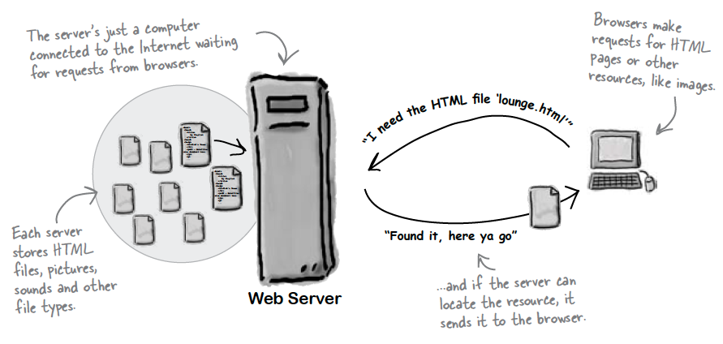
What does Web Server do?

Slide 6
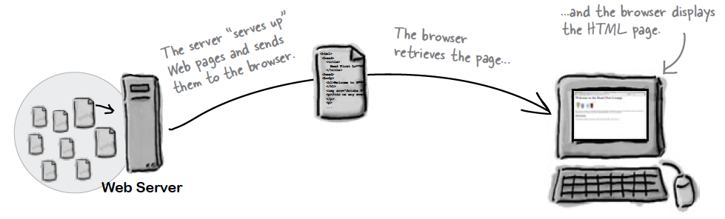
What does Web Browser do?

Slide 7
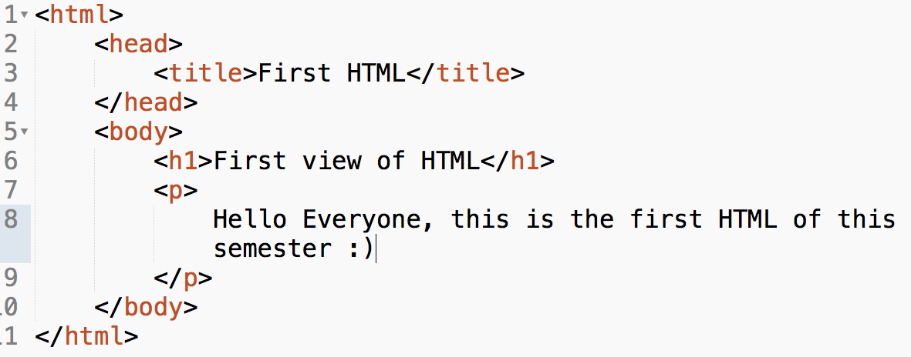
Checkout what is in HTML?

Slide 8
What is HTML?
HTML stands for Hyper Text Markup Language
Tell the browser about content & structure
.html or .htm file extension will make html file

Slide 9
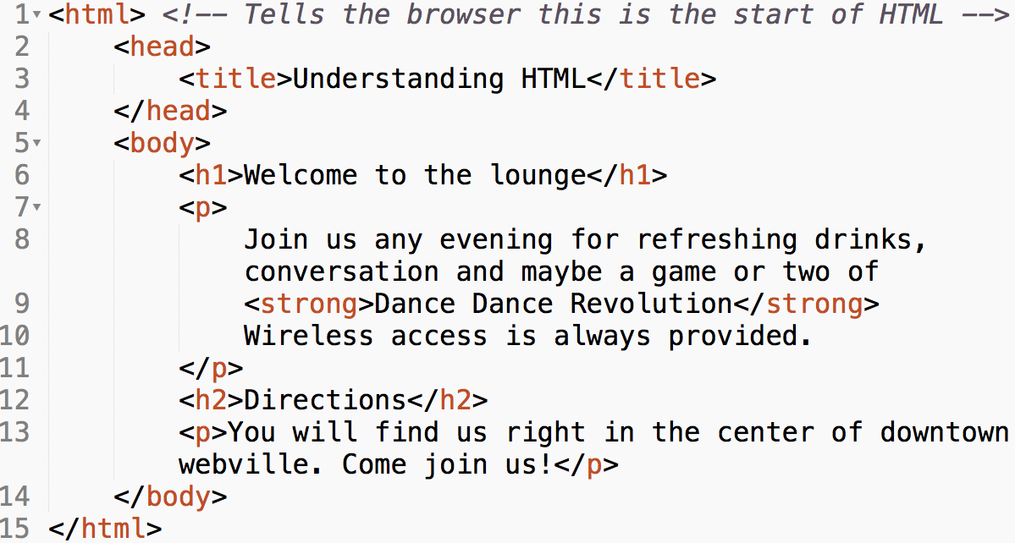
Identify HTML Tags

Slide 10
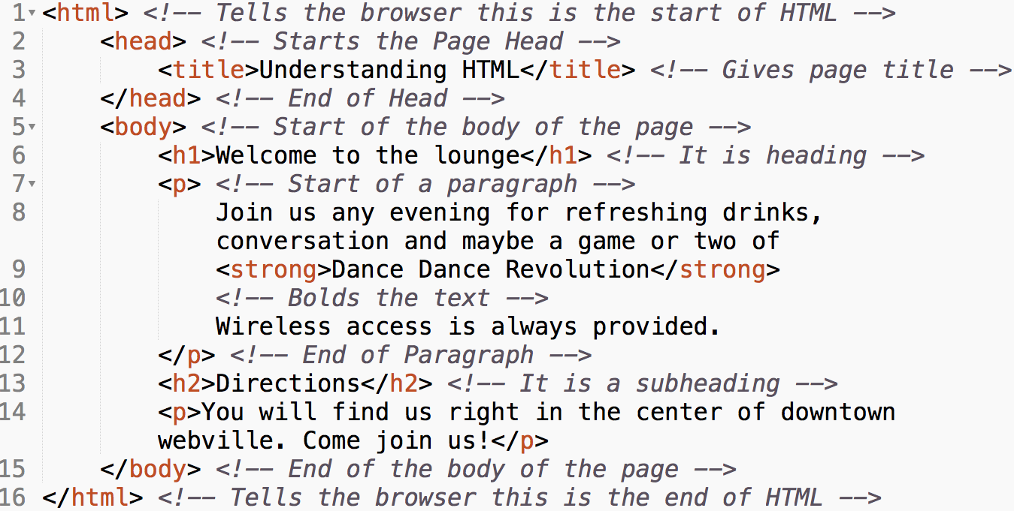
Identify HTML Tags

Slide 11
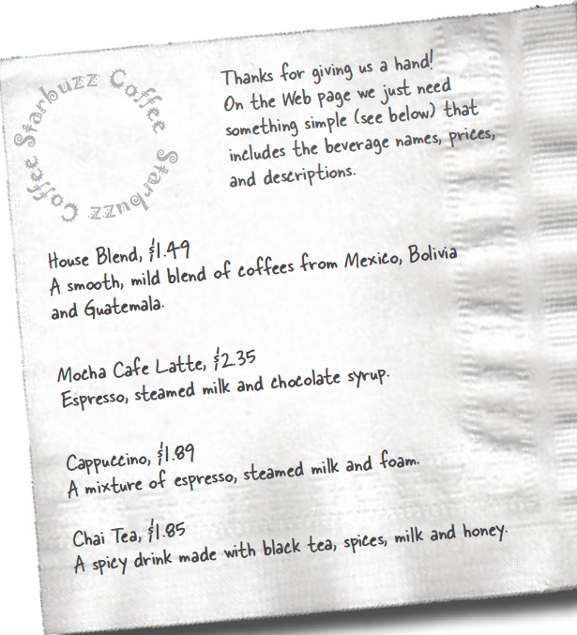
Make your hands dirty!

Slide 12
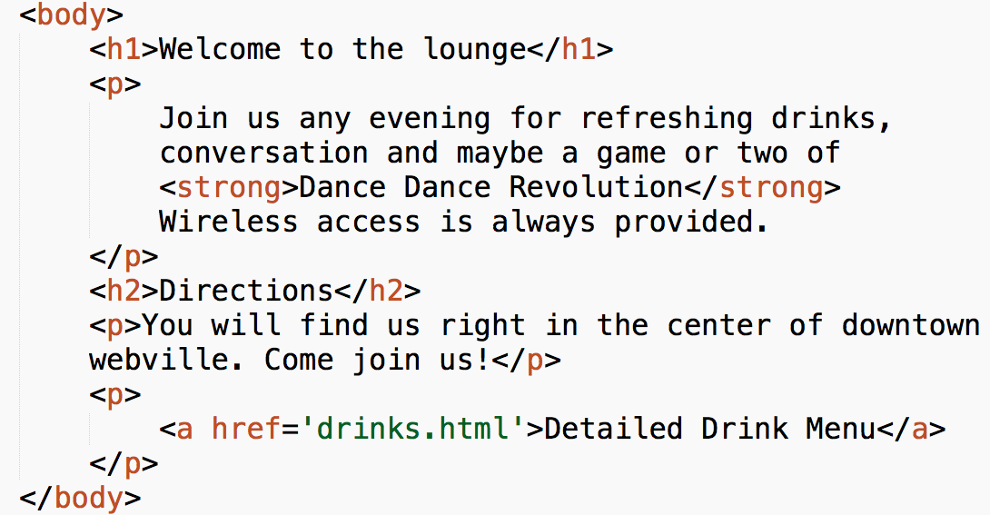
Linking Web Pages

Slide 13
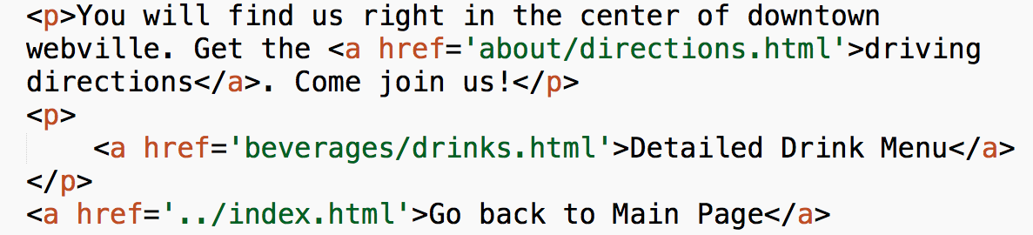
Linking Web Pages

Slide 14
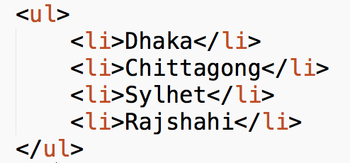
Listing

Slide 15
Listing Tags
ul -> unordered list
ol -> ordered list
li -> list item

Slide 16
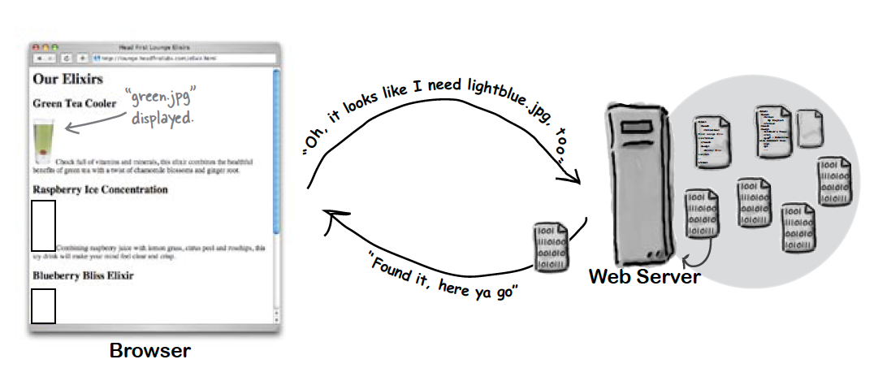
Meeting the Media

Slide 17
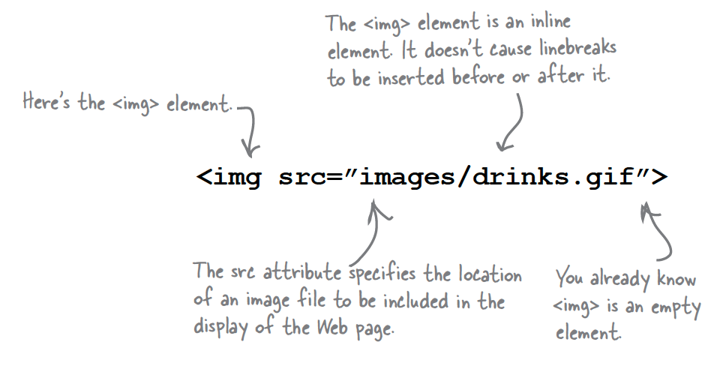
Image Tag

Slide 18
Block vs. Inline
Block | Inline
Stands on its own | Goes with the flow
<h1>, <h2>, <p>, <div>, <table> | <a>,<strong>, <img>, <span>

Slide 19
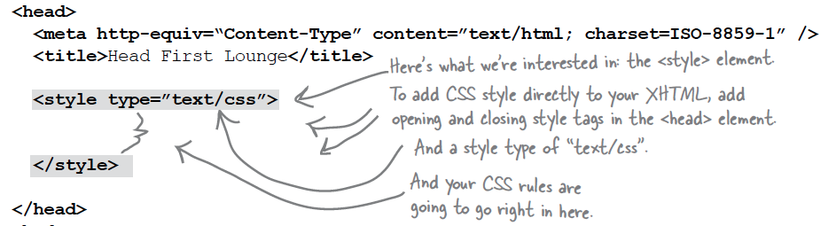
Exploring CSS

Slide 20
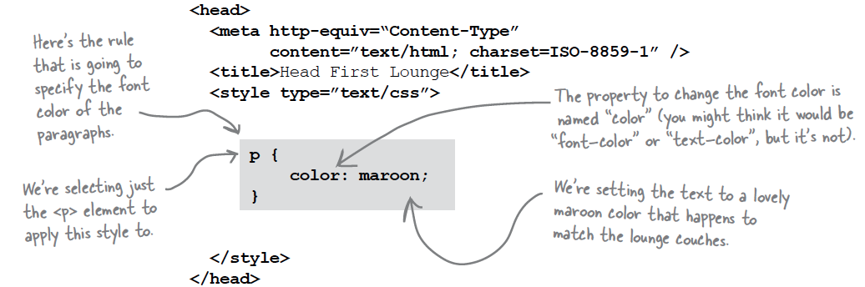
Exploring CSS

Slide 21
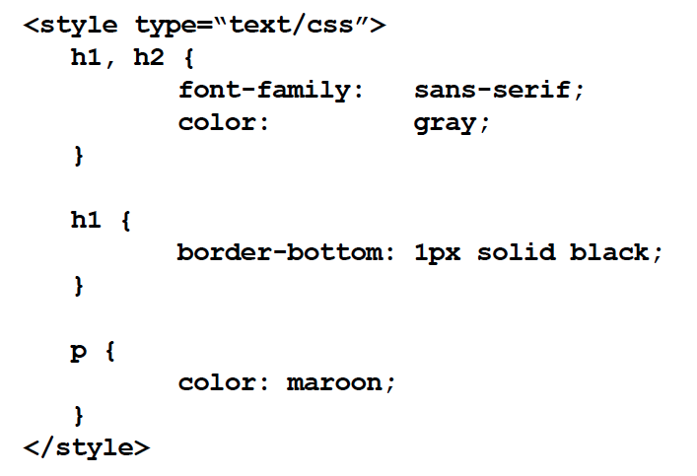
Try yourself!

Slide 22
Important CSS Property
Color - used to set font color of text elements
Font-weight - controls the weight of the text
Left - how to position left side of the element
Line-height - sets space between lines
Background-color – sets the background color
Border – puts a border around the element
Font-size – makes text bigger or smaller

Slide 23
Important CSS Property
Margin – give space between element & its content.
Background-image – put image behind
Text-align – used to align your text
Font-style – used for italic or oblique text
List-style – used to change the appearance of of list items

Slide 24
